Slide 1
Final Assignment SCS-2682-024 Mobile Applications for Android Devices
By Edmund Wong

Slide 2
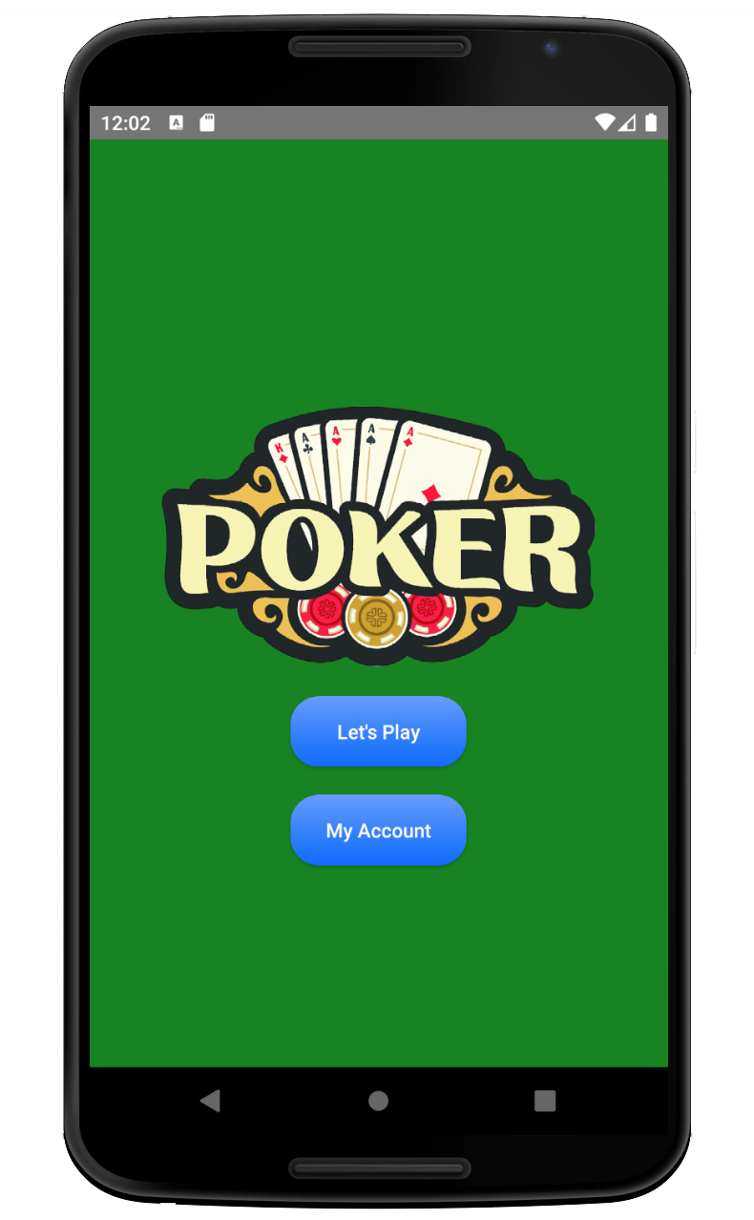
Casino App – Poker Slot Machine
A game app that simulates the poker slot machine at a real casino.
There are 3 features:
Play the game
Check your status
Add Credit

Slide 3
AndroidManifest.xml
<?xml version="1.0" encoding="utf-8"?> <manifest xmlns:android="http://schemas.android.com/apk/res/android" xmlns:tools="http://schemas.android.com/tools" package="com.ut.casinoapp">
<uses-permission android:name="android.permission.WRITE_EXTERNAL_STORAGE"/> <uses-permission android:name="android.permission.READ_EXTERNAL_STORAGE"/> <application android:fullBackupContent="true" android:allowBackup="true" android:icon="@mipmap/ic_launcher" android:label="@string/poker" android:roundIcon="@mipmap/ic_launcher_round" android:supportsRtl="true" android:theme="@style/Theme.AppCompat.Light.NoActionBar">
<activity android:name=".MainActivity" android:screenOrientation="sensor"> <intent-filter> <action android:name="android.intent.action.MAIN" /> <category android:name="android.intent.category.LAUNCHER" /> </intent-filter> </activity>
<activity android:name=".PokerActivity" android:parentActivityName=".MainActivity" android:screenOrientation="sensor" android:label="@string/poker" android:windowSoftInputMode="adjustPan" tools:targetApi="jelly_bean"> <meta-data android:name="android.support.PARENT_ACTIVITY" android:value=".MainActivity" /> </activity>
<activity android:name=".PayoutActivity" android:parentActivityName=".PokerActivity" android:screenOrientation="sensor" android:label="@string/payout" tools:targetApi="jelly_bean"> <meta-data android:name="android.support.PARENT_ACTIVITY" android:value=".PokerActivity" /> </activity> <activity android:name=".AccountActivity" android:parentActivityName=".MainActivity" android:screenOrientation="sensor" android:label="@string/account" android:windowSoftInputMode="adjustPan" tools:targetApi="jelly_bean"> <meta-data android:name="android.support.PARENT_ACTIVITY" android:value=".MainActivity" /> </activity> <activity android:name=".StatsDetailActivity" android:parentActivityName=".AccountActivity" android:screenOrientation="sensor" android:label="@string/jackpot" tools:targetApi="jelly_bean"> <meta-data android:name="android.support.PARENT_ACTIVITY" android:value=".AccountActivity" /> </activity> </application> </manifest>
To detect
orientation
To store data locally
To allow keyboard show on top of screen
To remove
default toolbar

Slide 4
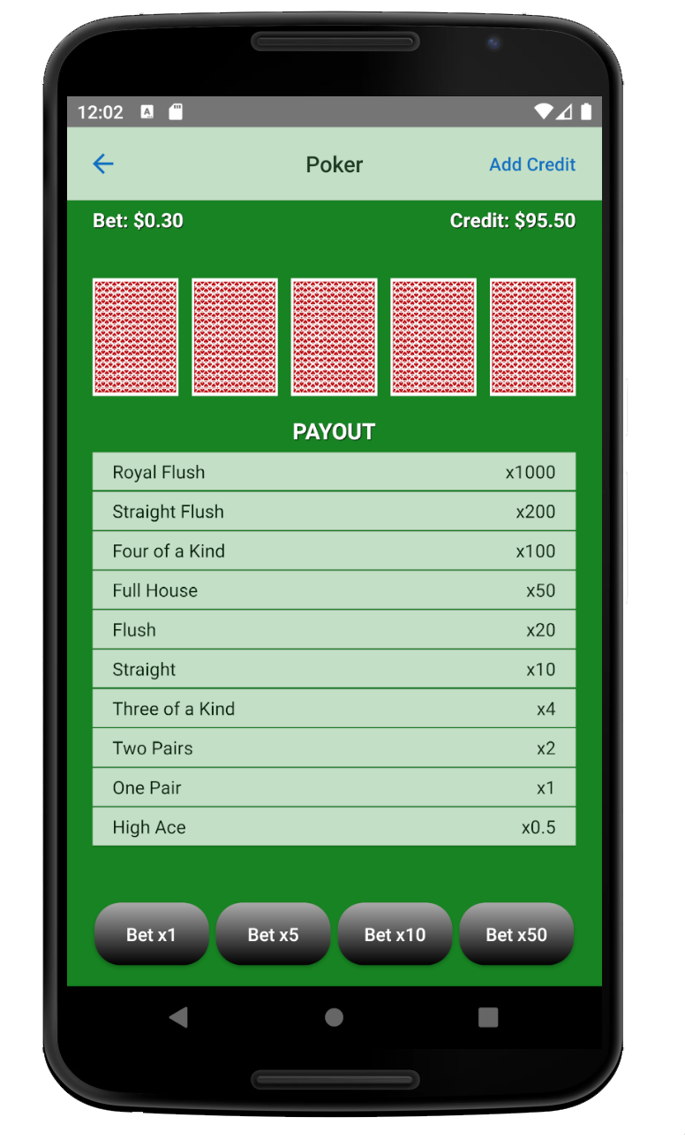
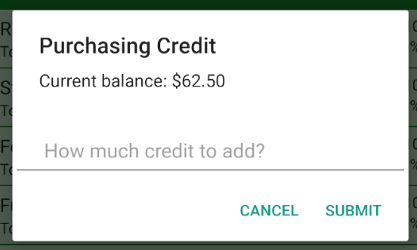
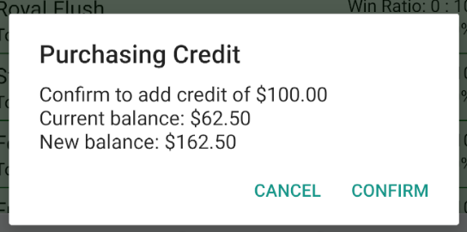
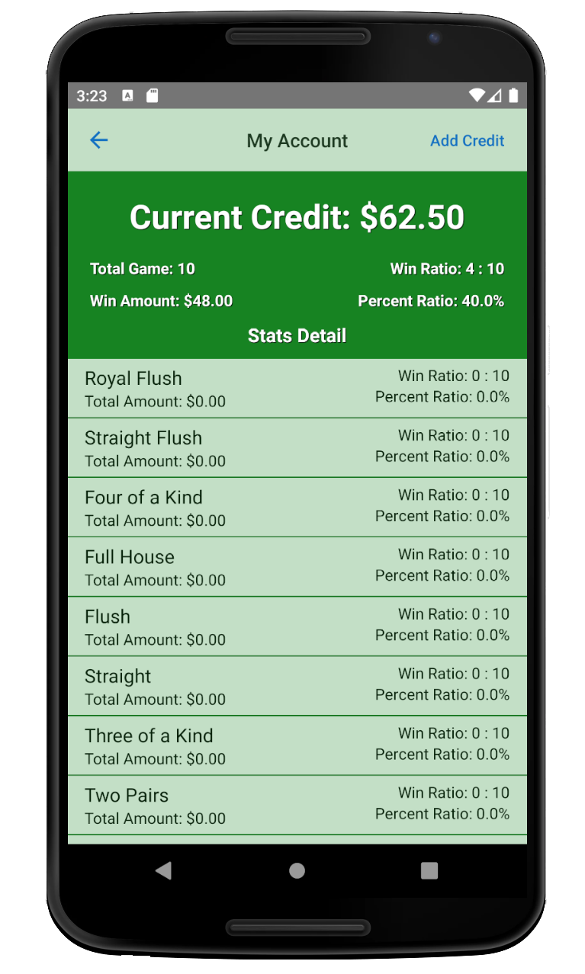
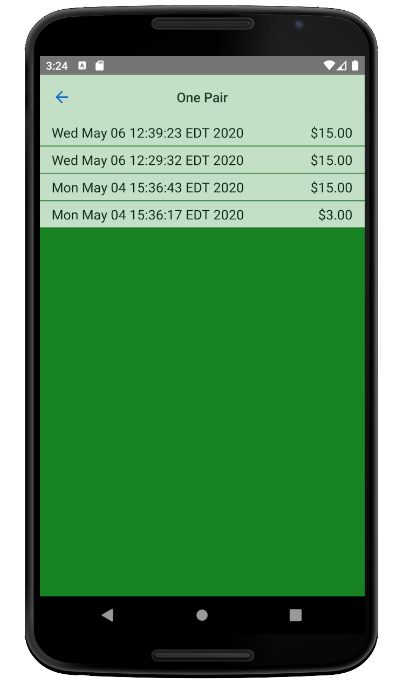
Storyboard – Vertical Orientation

Slide 5
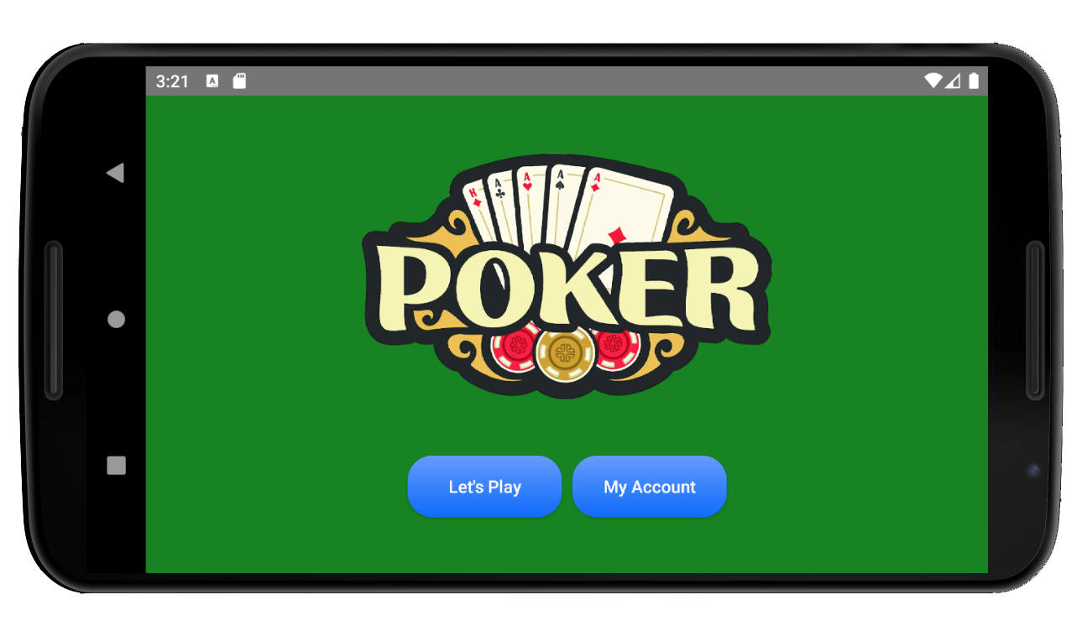
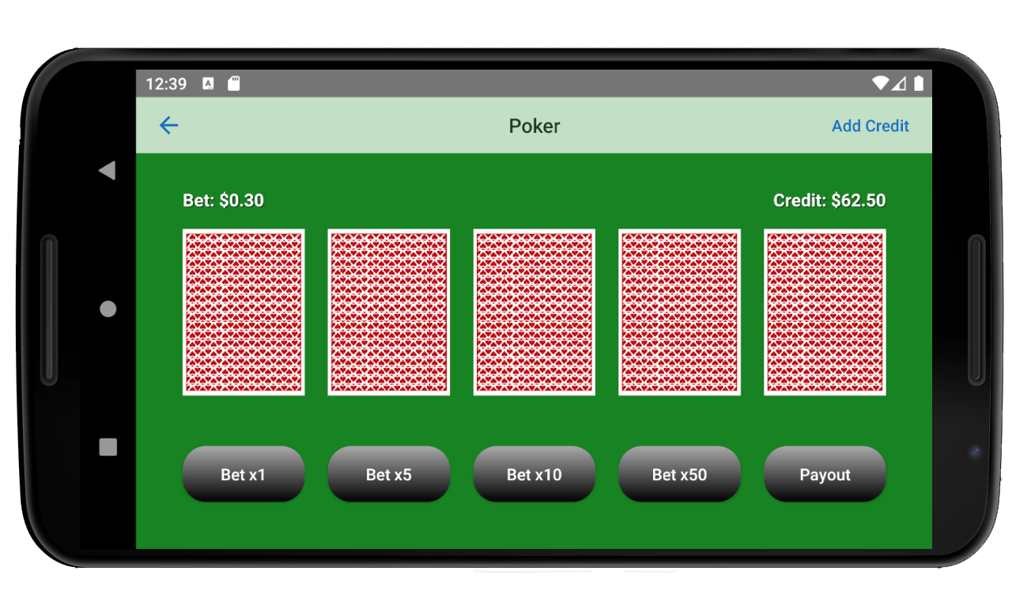
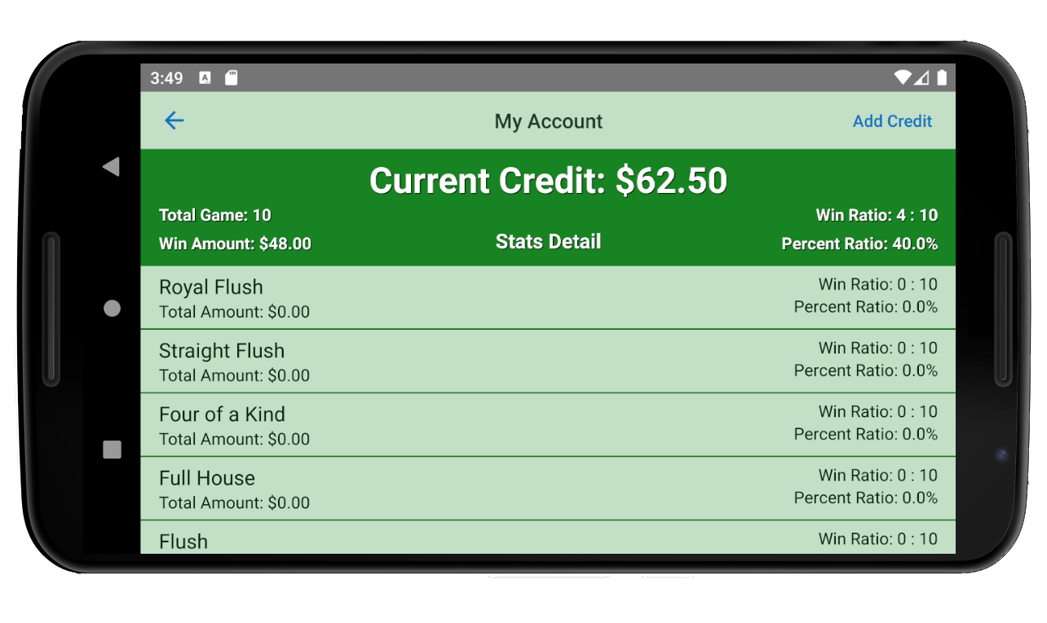
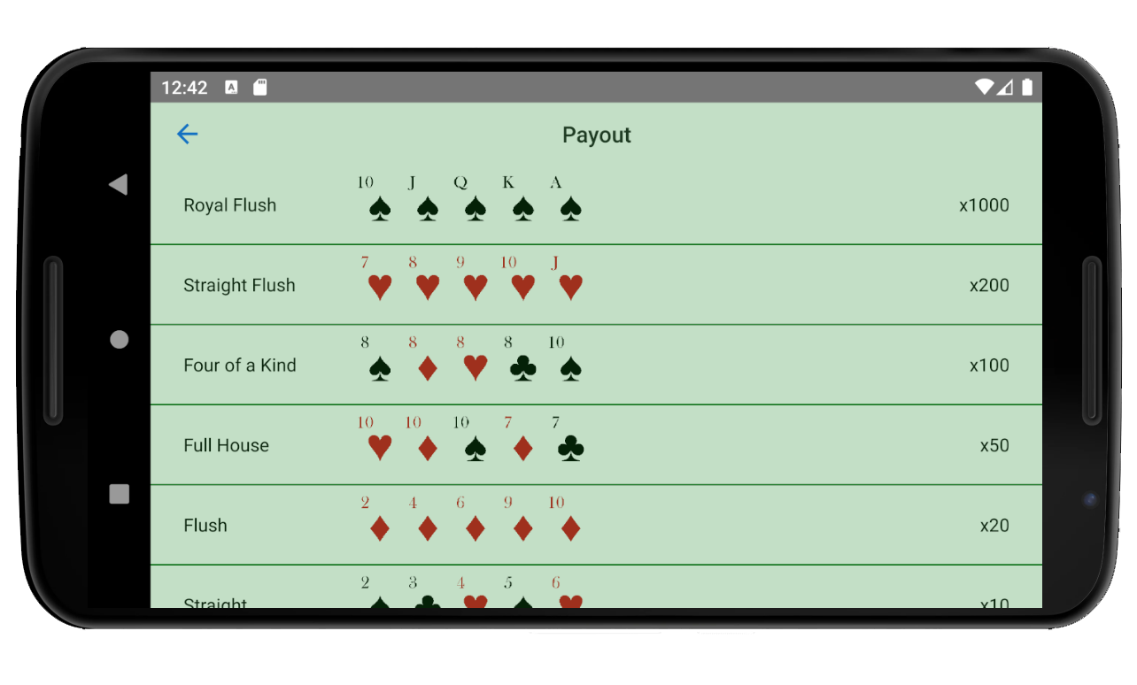
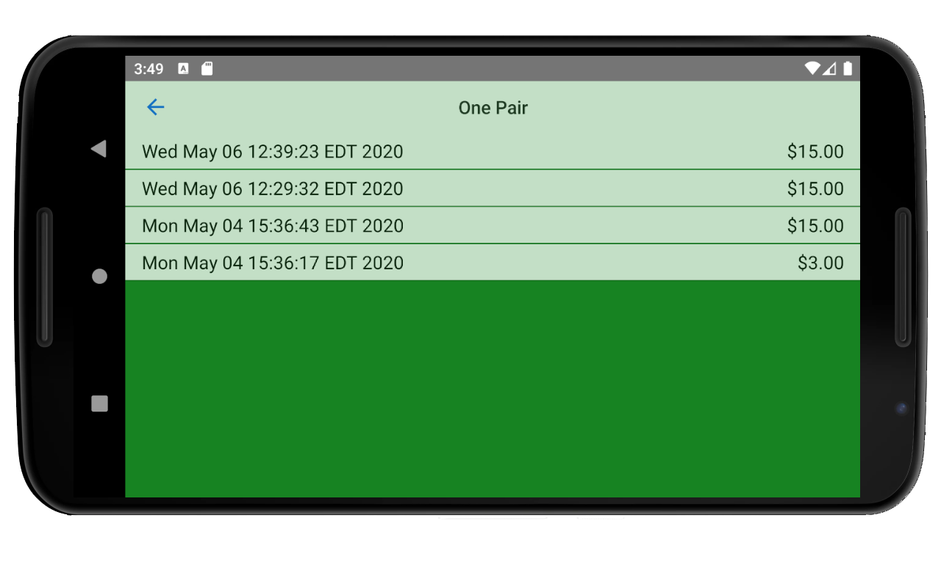
Storyboard – Horizontal Orientation

Slide 6
MainActivity Class
public class MainActivity extends AppCompatActivity{ private final static String TAG = "CasinoApp"; @Override protected void onCreate(Bundle savedInstanceState) { super.onCreate(savedInstanceState); setContentView(R.layout.activity_main); } public void onClick(View view) { Log.i(TAG, "onClick called: "+ ((Button) view).getText().toString() + " Button"); ToneGenerator tg = new ToneGenerator(AudioManager.STREAM_NOTIFICATION, 100); tg.startTone(ToneGenerator.TONE_PROP_BEEP); Class getClass; switch (view.getId()){ case R.id.button1: getClass = PokerActivity.class; break; case R.id.button2: getClass = AccountActivity.class; break; default: throw new IllegalStateException("Unexpected value: " + view.getId()); } Intent intent = new Intent(this, getClass); startActivity(intent); } }
Android Default Sound

Slide 7
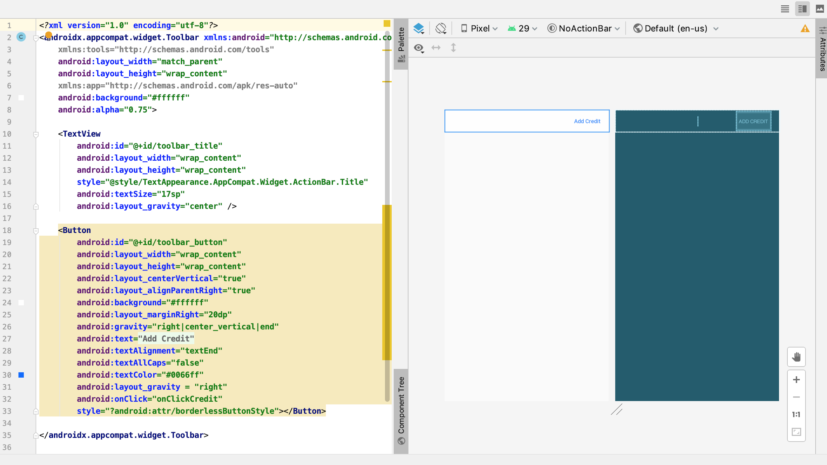
Custom Toolbar

Slide 8
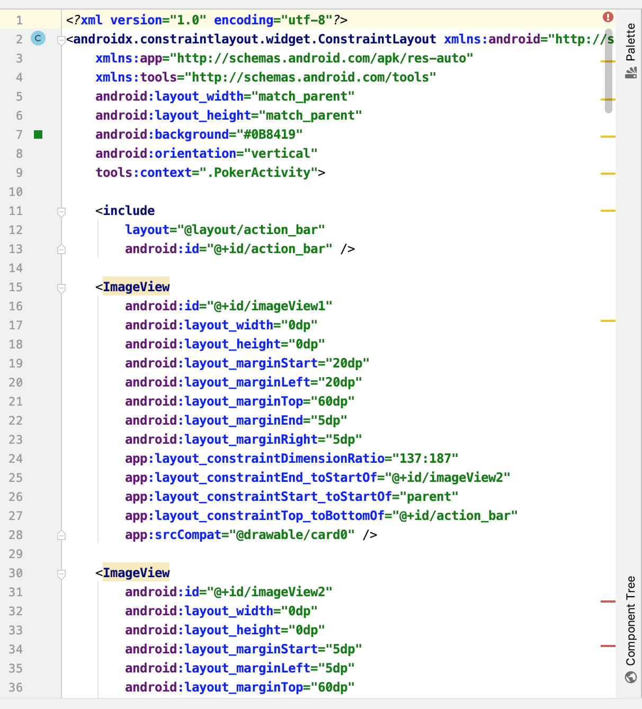
Custom Toolbar
For each layout, I use <include> tag to call the custom toolbar
In the onCreate() method for each activity, I’ve put the following code:
Toolbar toolbar = (Toolbar) findViewById(R.id.action_bar); setSupportActionBar(toolbar); getSupportActionBar().setDisplayHomeAsUpEnabled(true); toolbar.getNavigationIcon().setColorFilter(getResources().getColor(R.color.colorBlue), PorterDuff.Mode.SRC_ATOP); TextView mTitle = (TextView) toolbar.findViewById(R.id.toolbar_title); mTitle.setText(toolbar.getTitle()); getSupportActionBar().setDisplayShowTitleEnabled(false); Button mButton = (Button) toolbar.findViewById(R.id.toolbar_button); mButton.setEnabled(true); mButton.setVisibility(View.VISIBLE);
//mButton.setVisibility(View.GONE); for no button

Slide 9
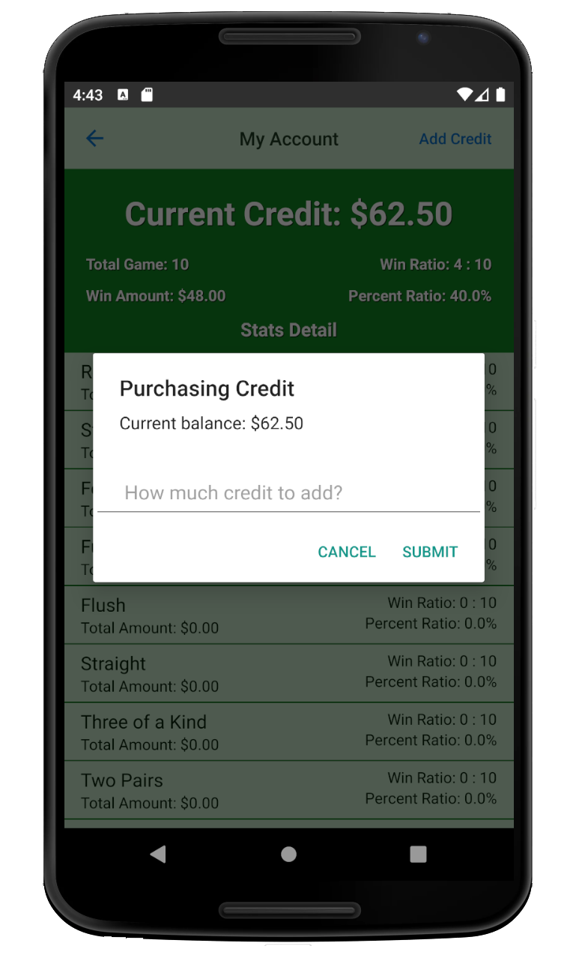
Custom Toolbar – Add Credit Button
public void onClickCredit(View view){ Log.i(TAG, "onClickCredit called"); final EditText input = new EditText(this); input.setInputType(InputType.TYPE_CLASS_NUMBER | InputType.TYPE_NUMBER_FLAG_DECIMAL); input.setHint("How much credit to add?"); input.setPadding(100,50,100,50); final String title = "Purchasing Credit"; final String currentBalance = "Current balance: $" + formatter.format(balance); final AlertDialog.Builder confirmAlert = new AlertDialog.Builder(this); AlertDialog.Builder creditAlert = new AlertDialog.Builder(this); creditAlert.setMessage(currentBalance); creditAlert.setView(input); creditAlert.setTitle(title); creditAlert.setPositiveButton("Submit", new DialogInterface.OnClickListener() { public void onClick(DialogInterface dialog, int id) { final double credit = Double.parseDouble(input.getText().toString()); String addCredit = "Confirm to add credit of $"+ formatter.format(credit); String newBalance = "New balance: $"+ formatter.format(balance+credit); String confirmMessage = addCredit +"\n"+ currentBalance +"\n"+ newBalance; confirmAlert.setTitle(title); confirmAlert.setMessage(confirmMessage); confirmAlert.setPositiveButton("Confirm",new DialogInterface.OnClickListener() { public void onClick(DialogInterface dialog, int id) { new PokerData().save(PokerActivity.this, "Add Credit", credit, (balance+credit),false); finish(); startActivity(getIntent()); } }); confirmAlert.setNegativeButton("Cancel",null); confirmAlert.create().show(); } }); creditAlert.setNegativeButton("Cancel",null); creditAlert.create().show(); }
Confirm message after clicking Submit

Slide 10
Payout Data From JSON File

Slide 11
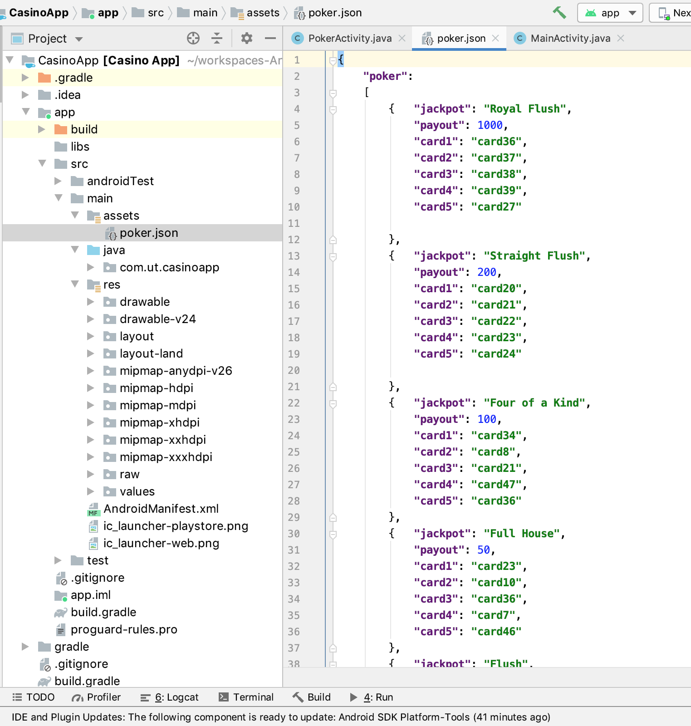
Load Payout Data From JSON File
Create the following method to read JSON data:
public String loadJSONFromAsset() { String json = null; try { InputStream is = getAssets().open("poker.json"); int size = is.available(); byte[] buffer = new byte[size]; is.read(buffer); is.close(); json = new String(buffer, "UTF-8"); } catch (IOException ex) { ex.printStackTrace(); return null; } return json; }
In onCreate() method, I’ve put the following code:
try { ArrayList<HashMap<String, String>> payoutList = new ArrayList<>(); ListView lv = (ListView) findViewById(R.id.payout_list); JSONObject jObj = new JSONObject(loadJSONFromAsset()); JSONArray jsonArry = jObj.getJSONArray("poker"); for (int i = 0; i < jsonArry.length(); i++) { HashMap<String, String> payout = new HashMap<>(); JSONObject obj = jsonArry.getJSONObject(i); payout.put("jackpot", obj.getString("jackpot")); payout.put("payout", "x" + obj.getString("payout")); payoutList.add(payout); } ListAdapter adapter = new SimpleAdapter(this, payoutList, R.layout.payout_table,new String[]{"jackpot","payout"}, new int[]{R.id.jackpot, R.id.payout}); lv.setAdapter(adapter); }catch (JSONException e){ }
New Assets Folder

Slide 12
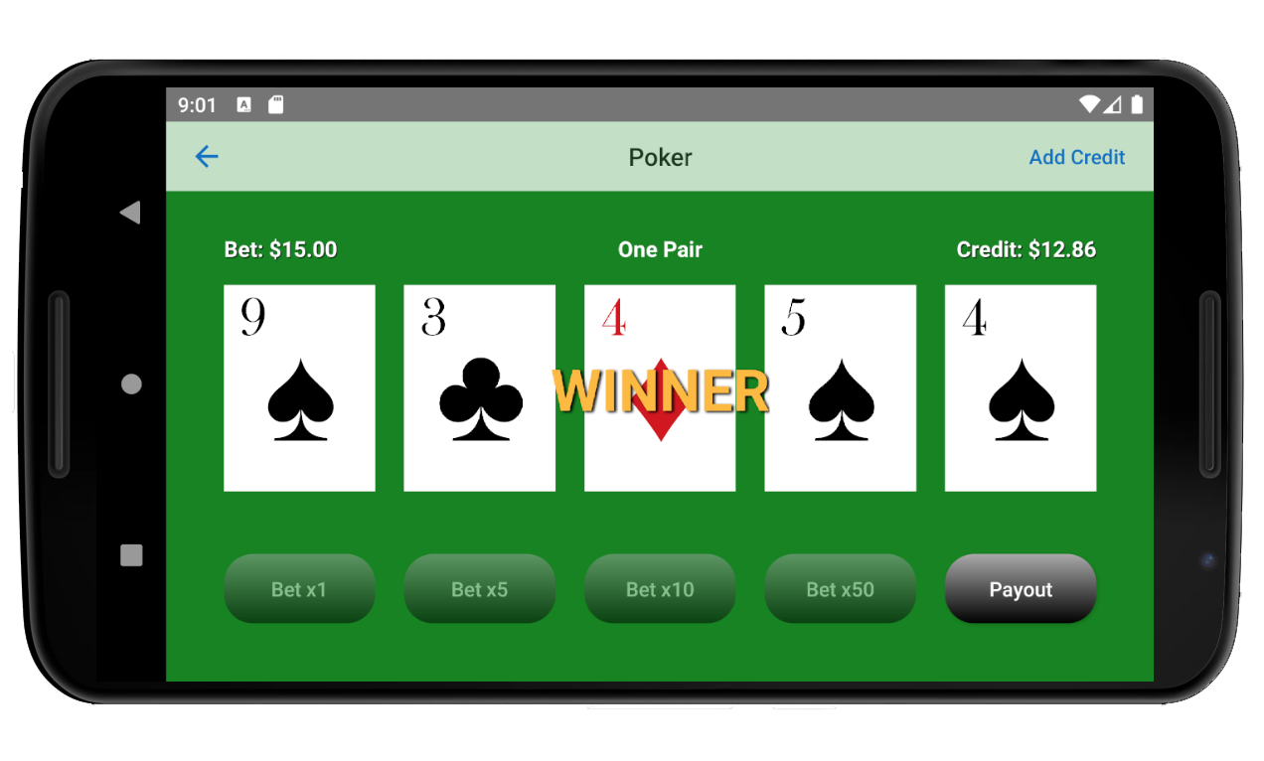
onClickBet() Method Life Cycle
onClickBet()
Disable Bet Buttons
Play Sound
Set Bet Amount
Subtract Credit Amount
Get Cards Value
Set Default Values
Random Cards
Flip Cards
Calculate Jackpot
Define Cards
Sort and Set Cards
Sort Ace Card
Compare Cards for Straight
Run Calculation
Game Finish
Play Win/Lose Sound
Increase Credit
Save Results
Enable Bet Buttons

Slide 13
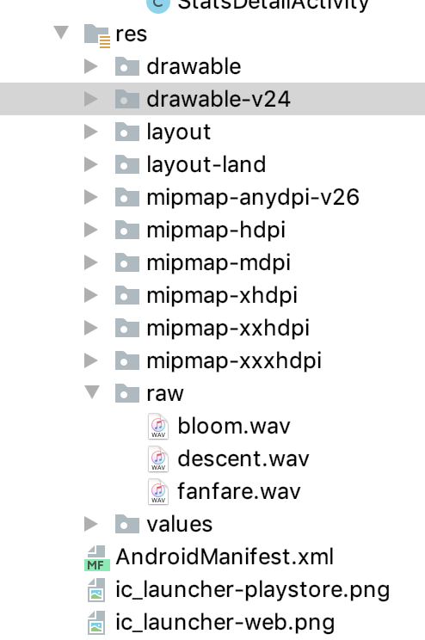
Set Default Values
Handler handler = new Handler();
jackpotLabel.setText(""); winLabel.setAlpha(0); String buttonText = ((Button) view).getText().toString(); String[] betLabelSplitText = buttonText.split("x"); Double betValue = Double.parseDouble(betLabelSplitText[1]) * 0.3;
//Disable Bet Buttons for (int i=0; i< 4; i++) { String buttonName = "betButton" + String.valueOf(i + 1); int buttonId = getResources().getIdentifier(buttonName, "id", getPackageName()); Button button = (Button) findViewById(buttonId); button.setEnabled(false); button.setAlpha((float) 0.5); }
//Play Sound MediaPlayer bloomSound = MediaPlayer.create(this,R.raw.bloom); bloomSound.setVolume((float) 100, (float) 100); bloomSound.start();
//Set Bet Amount TextView betLabel = (TextView) findViewById(R.id.betLabel); String newBetLabel = "Bet: $" + formatter.format(betValue); betLabel.setText(newBetLabel);
//Subtract Credit Amount String creditText = creditLabel.getText().toString(); String[] creditLabelSplitText = creditText.split(Matcher.quoteReplacement("$")); final Double creditValue = Double.parseDouble(creditLabelSplitText[1]) - betValue; String newCreditLabel = "Credit: $" + formatter.format(creditValue); creditLabel.setText(newCreditLabel);
Imported sound

Slide 14
Get Cards Value
//Random Cards final ArrayList<Integer> cardArray = new ArrayList<Integer>(Arrays.asList(0,0,0,0,0)); for (int i = 0; i < 5; i++) { String imageName = "imageView"+ String.valueOf(i+1); int imageId = getResources().getIdentifier(imageName, "id", getPackageName()); ImageView image = (ImageView) findViewById(imageId); int drawableId = getResources().getIdentifier("card0","drawable",getPackageName()); image.setImageResource(drawableId); int random = 0; while (cardArray.contains(random)) { random = new Random().nextInt(51) + 1; } cardArray.set(i,random); }
//Flip Cards for (int i = 0; i < 5; i++) { final int a = i; handler.postDelayed(new Runnable() { @Override public void run() { String imageName = "imageView"+ String.valueOf(a+1); int imageId = getResources().getIdentifier(imageName, "id", getPackageName()); ImageView image = (ImageView) findViewById(imageId); String cardName = "card" + String.valueOf(cardArray.get(a)); int drawableId = getResources().getIdentifier(cardName,"drawable",getPackageName()); image.setImageResource(drawableId); } }, (a+1)*250); }

Slide 15
Calling calculateJackpot() Method
private int calculateJackpot(ArrayList arrayList){ Log.i(TAG, "calculateJackpot called"); ArrayList cardValue = new ArrayList<Integer>(Arrays.asList(0,0,0,0,0)); ArrayList cardSymbol = new ArrayList<Integer>(Arrays.asList(0,0,0,0,0)); ArrayList aceCard = new ArrayList<Integer>(Arrays.asList(0,0,0,0,0)); ArrayList compareCard = new ArrayList<Boolean>(Arrays.asList(false,false,false,false,false)); ArrayList aceCompareCard = new ArrayList<Boolean>(Arrays.asList(false,false,false,false,false)); //Define Cards for (int i=0; i<5; i++) { cardValue.set(i, (Integer.parseInt(arrayList.get(i).toString()) - 1) % 13 + 1); cardSymbol.set(i, (Integer.parseInt(arrayList.get(i).toString()) - 1) / 13); } //Sort and Set Cards ArrayList sortCardValue = cardValue; Collections.sort(sortCardValue); Set<String> setCardValue = new HashSet<String>(cardValue); Set<String> setCardSymbol = new HashSet<String>(cardSymbol); //Sort Ace Card if (Integer.parseInt(sortCardValue.get(0).toString()) == 1){ for (int i=1; i<5; i++){ aceCard.set(i-1,Integer.parseInt(sortCardValue.get(i).toString())); } aceCard.set(4, 14); }else{ aceCard = sortCardValue; } //Compare Cards for Straight for (int i=0; i<5; i++){ compareCard.set(i,Integer.parseInt(sortCardValue.get(i).toString()) == Integer.parseInt(Collections.min(sortCardValue).toString()) + i); aceCompareCard.set(i,Integer.parseInt(aceCard.get(i).toString()) == Integer.parseInt(Collections.min(aceCard).toString()) + i); }

Slide 16
Calling calculateJackpot() Method
(continue)
//Run Calculation switch (setCardValue.size()){ case 2: //2 Sets of Numbers ArrayList count2 = new ArrayList<Integer>(Arrays.asList(0,0)); for (int i=0;i<2;i++){ count2.set(i, Collections.frequency(cardValue, Integer.parseInt(setCardValue.toArray()[i].toString()))); } if (Integer.parseInt(Collections.max(count2).toString()) == 4){ //Four of a Kind return 2; }else{ //Full House return 3; } case 3: //2 Sets of Numbers ArrayList count3 = new ArrayList<Integer>(Arrays.asList(0,0,0)); for (int i=0;i<3;i++) { count3.set(i, Collections.frequency(cardValue, Integer.parseInt(setCardValue.toArray()[i].toString()))); } if (Integer.parseInt(Collections.max(count3).toString()) == 3){ //Three of a Kind return 6; }else{ //Two Pairs return 7; } case 4: //4 Sets of Numbers (aka One Pair) return 8;
default: //5 Sets of Numbers - all different numbers if (aceCompareCard.contains(false)){ //No Royal if (compareCard.contains(false)){ //No Straight if (setCardSymbol.size() == 1){ //Flush return 4; }else{ //No Flush for (int i=0;i<5;i++){ if (Integer.parseInt(arrayList.get(i).toString()) == 27){ //High Ace return 9; } } return 10; } }else{ //Straight if (setCardSymbol.size() == 1){ //Flush return 2; }else{ //No Flush return 5; } } }else{ //Royal if (setCardSymbol.size() == 1){ //Flush return 0; }else{ //No Flush return 5; } } } }

Slide 17
Game Finish
If there’s a Jackpot
No Jackpot
if (payout != 10){ String payoutList = lv.getItemAtPosition(payout).toString(); payoutList = payoutList.replaceAll("[{}]",""); String[] payoutListSplitText = payoutList.split("[,=]"); payoutListSplitText[3] = payoutListSplitText[3].replace("x",""); jackpotMessage = payoutListSplitText[1]; jackpotAmount = Double.parseDouble(payoutListSplitText[3]) * betValue; final String finalJackpotMessage = jackpotMessage; final Double finalJackpotAmount = jackpotAmount; handler.postDelayed(new Runnable() { @Override public void run() { jackpotLabel.setText(finalJackpotMessage); winLabel.setAlpha(1); MediaPlayer fanfareSound = MediaPlayer.create(PokerActivity.this,R.raw.fanfare); fanfareSound.setVolume((float) 100, (float) 100); fanfareSound.start(); final Timer timer = new Timer(); TimerTask tasknew = new TimerTask(){ int i = 0; public void run() { int counter = (int) (finalJackpotAmount * 100); if (i < counter) { double amount = (double) ++i/100; final String newCreditLabel = "Credit: $" + formatter.format(creditValue + amount); runOnUiThread(new Runnable() { public void run() { creditLabel.setText(newCreditLabel); } }); }else{ timer.cancel(); timer.purge(); } } }; timer.schedule(tasknew,1, 1); } }, 1500);
}else{ jackpotMessage = "No Win"; handler.postDelayed(new Runnable() { @Override public void run() { MediaPlayer descentSound = MediaPlayer.create(PokerActivity.this, R.raw.descent); descentSound.setVolume((float) 100, (float) 100); descentSound.start(); } },1500); }
final double credit = creditValue + jackpotAmount; new PokerData().save(this, jackpotMessage, jackpotAmount, credit,true); handler.postDelayed(new Runnable() { @Override public void run() { setButton(credit); } }, (int) (1501 + jackpotAmount * 100 / 0.027));
Save Data & Enable Button

Slide 18
public class PokerData extends AppCompatActivity {
Save Data
Load Data
private static final String FILE_NAME = "pokerdata.txt";
public void save(Context context, String jackpot, Double jackpotAmount, Double score, Boolean play){ Date date = new Date(); String text = (String) String.valueOf(date.getTime()) + "," + jackpot + "," + jackpotAmount + "," + score + "," + play; File file = new File(context.getFilesDir(),FILE_NAME); StringBuilder content = new StringBuilder(); try { if (file.exists()){ BufferedReader reader = new BufferedReader(new FileReader(file)); String line; while ((line = reader.readLine()) != null) { content.append(line); content.append("\n"); } reader.close(); } content.append(text); FileWriter writer = new FileWriter(file); writer.append(content); writer.flush(); writer.close(); } catch (Exception e) { } }
public String[][] loadContent(Context context){
File file = new File(context.getFilesDir(), FILE_NAME); try { if (file.exists()) { BufferedReader reader = new BufferedReader(new FileReader(file)); String[][] array = {{}}; String line; int i = 0; while ((line = reader.readLine()) != null){ String[] str = line.split(","); array = Arrays.copyOf(array, i + 1); array[i] = str; i++; } reader.close(); return array; } } catch (Exception e) { } return null; }

Slide 19
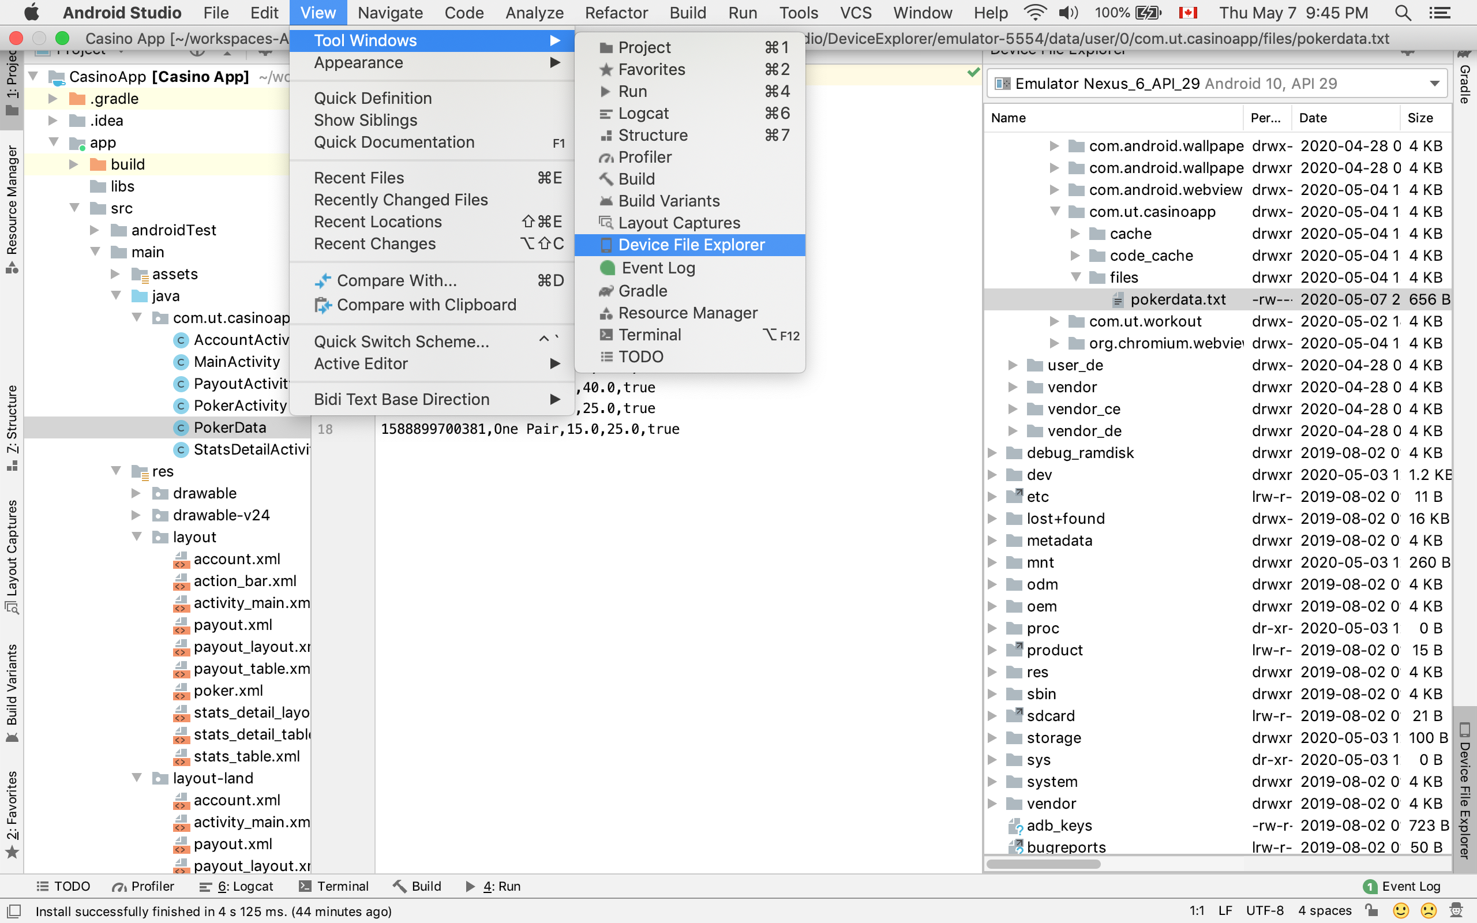
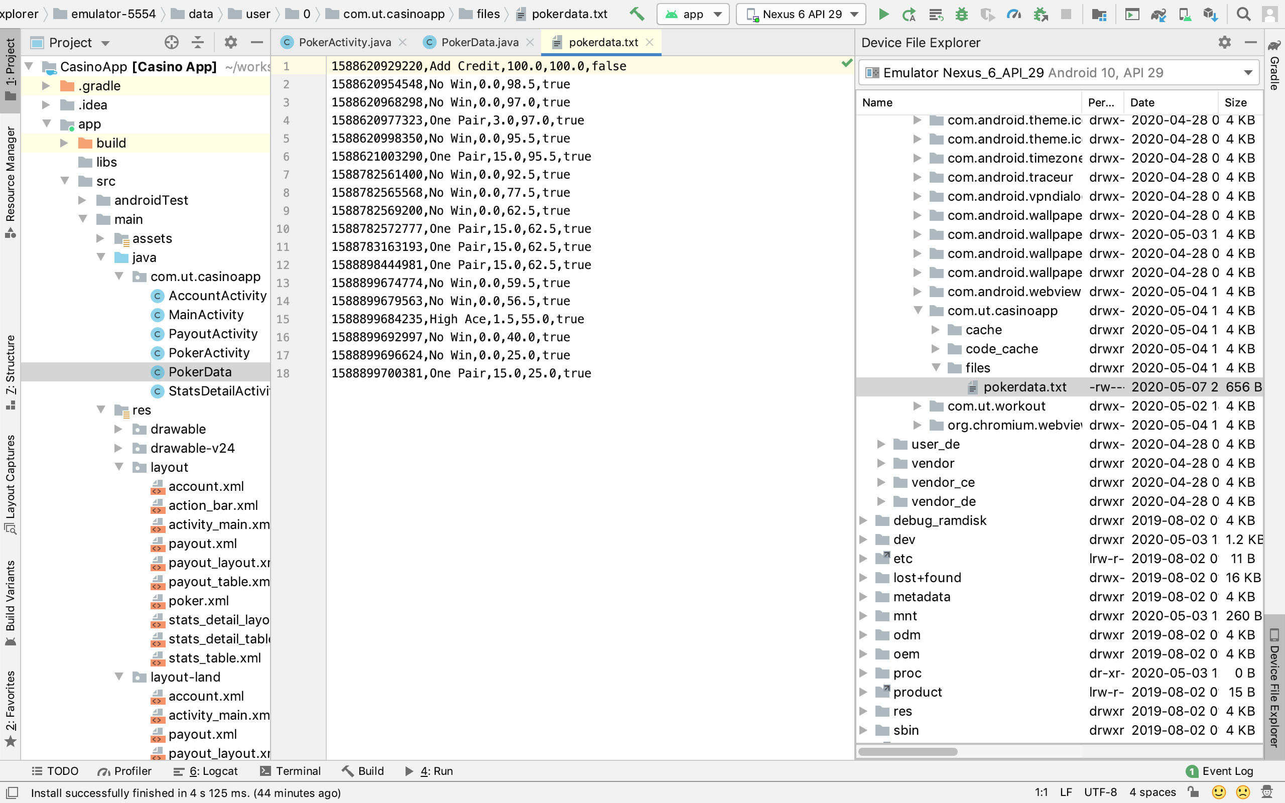
Retrieving Data

Slide 20
Loading and Passing Data

Slide 21
Loading and Passing Data
Account Activity
Stats Detail Activity
try{ ArrayList<HashMap<String, String>> statsList = new ArrayList<>(); ListView lv = (ListView) findViewById(R.id.stats_list); for (int i=0; i< array.length; i++){ HashMap<String, String> stats = new HashMap<>(); stats.put("jackpot", array[i][0]); stats.put("jackpotAmount", "Total Amount: $" + formatter.format(Double.parseDouble(array[i][2]))); stats.put("winRatio","Win Ratio: "+ Integer.parseInt(array[i][1]) + " : " + (int) count); stats.put("percentRatio","Percent Ratio: " + percentage.format(Double.parseDouble(array[i][1])/count)); statsList.add(stats); } ListAdapter adapter = new SimpleAdapter(this, statsList, R.layout.stats_table,new String[]{"jackpot","jackpotAmount","winRatio","percentRatio"}, new int[]{R.id.jackpot, R.id.jackpotAmount,R.id.winRatio,R.id.percentRatio}); lv.setAdapter(adapter); //Pass Data onItemClickListener final String[][] finalArray = array; AdapterView.OnItemClickListener itemClickListener = new AdapterView.OnItemClickListener() { @Override public void onItemClick(AdapterView<?> parent, View view, int position, long id) { Intent newIntent = new Intent(AccountActivity.this,StatsDetailActivity.class); newIntent.putExtra("Title", finalArray[position][0]); startActivity(newIntent); } }; lv.setOnItemClickListener(itemClickListener); }catch (Exception e){ }
Intent intent = getIntent(); String title = intent.getExtras().getString("Title");
String[][] content = new PokerData().loadContent(this); ArrayList<HashMap<String, String>> statsDetailList = new ArrayList<>(); ListView list = (ListView) findViewById(R.id.stats_detail); Date date = new Date(); try{ for (int i =0; i<content.length; i++){ HashMap<String, String> statsDetail = new HashMap<>(); if (content[i][1].contains(title)){ date.setTime(Long.parseLong(content[i][0])); statsDetail.put("Date",date.toString()); statsDetail.put("winAmount", "$"+formatter.format(Double.parseDouble(content[i][2]))); statsDetailList.add(statsDetail); } } Collections.reverse(statsDetailList); ListAdapter adapter = new SimpleAdapter(this, statsDetailList , R.layout.stats_detail_table,new String[]{"Date","winAmount"}, new int[]{R.id.date,R.id.winAmount}); list.setAdapter(adapter); }catch (Exception e){ }

Slide 22
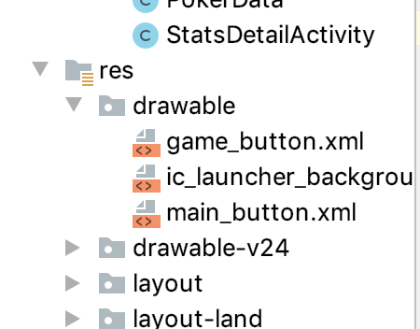
Button Effects
<?xml version="1.0" encoding="utf-8"?> <selector xmlns:android="http://schemas.android.com/apk/res/android" >
<item android:state_pressed="true" > <shape android:shape="rectangle" > <corners android:radius="20dp" /> <gradient android:angle="-90" android:startColor="#0066FF" android:endColor="#6699FF" /> </shape> </item>
<item > <shape android:shape="rectangle" > <corners android:radius="20dp" /> <gradient android:angle="-90" android:startColor="#6699FF" android:endColor="#0066FF" /> </shape> </item> </selector>

Slide 23
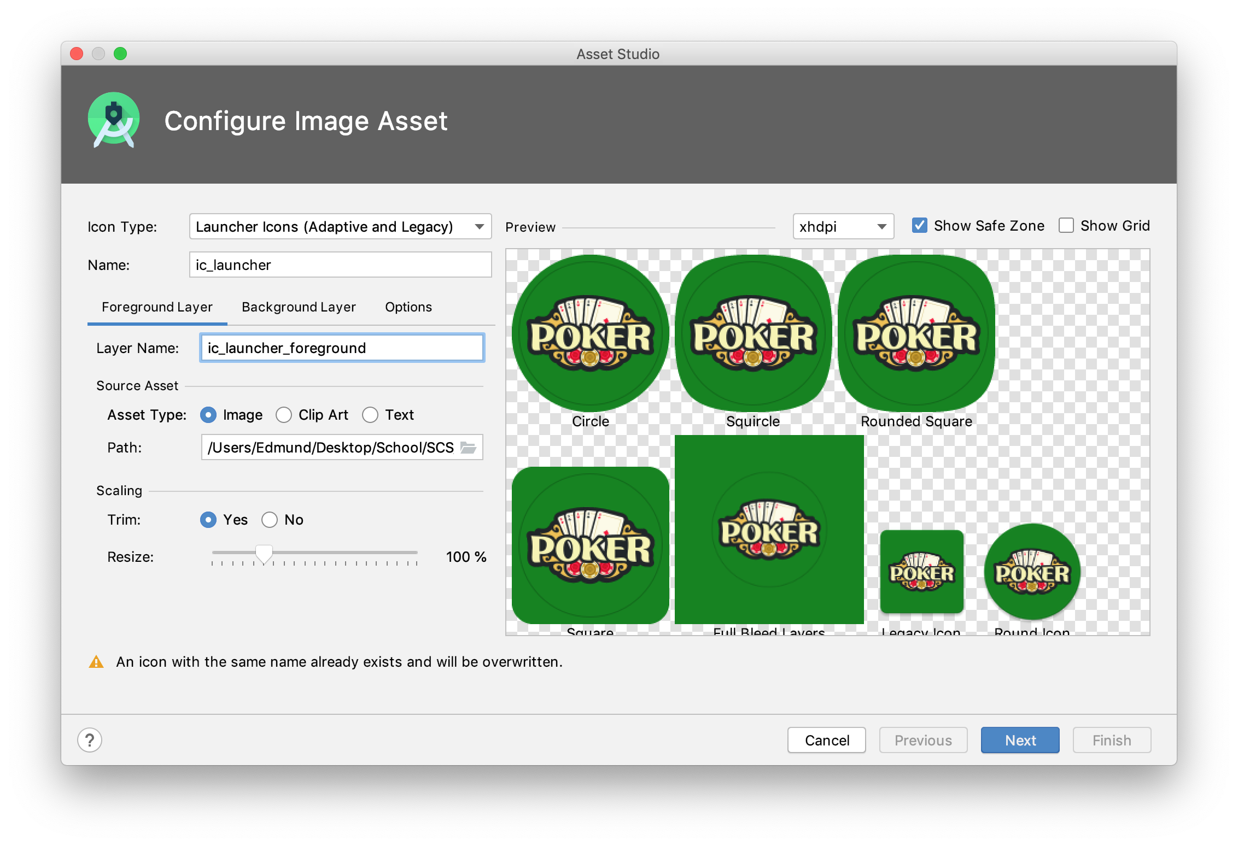
Creating Custom Logo Icon

Slide 24
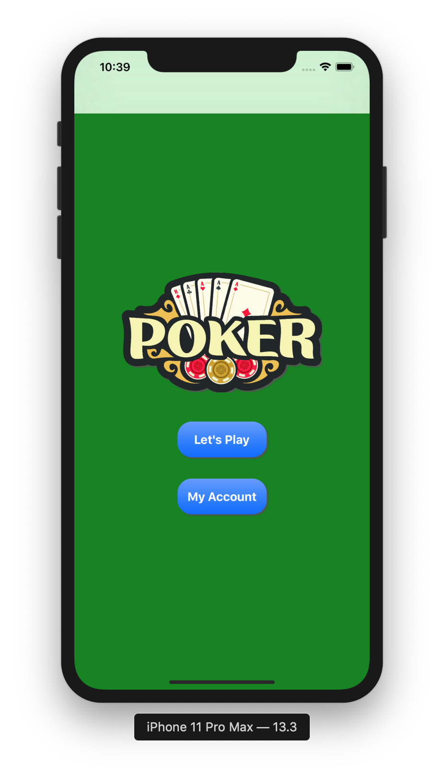
Available on Apple Device
Android Device
Apple Device

